Slide 1
NT1801

Slide 2
NIGERIA
2015
Presenting Every Man Perfect
2016
Long Enough On This Mount
2017
Lift Up Your Eyes And Look
2018
ASK OF ME

Slide 3
Little wonder the FGBMFI Literal Vision was birthed during a night of agonizing earnest prayer.
It should be obvious that for the vision to be sustained, the prayer altar must be kept alive and burning.
Whenever the Lord wants to revive his people, He first sets the hearts of men on fire with a prayer burden that consumes their beings and makes them restless until His will is done and His Kingdom comes.
(Acts 2:1-3)

Slide 4
There is a new wave of revival in FGBMFI Nigeria and the Lord is kindling a fire that has the capacity to overwhelm the whole world.
In recent times, He has asked us to present “everyone perfect”. He challenged us to go forward, saying, we have stayed “long enough on this mount.” In 2016 African Convention, He asked us to “Occupy till I come” before He ordered us to “lift up your eyes and look.”
Now, God is challenging us to ASK for what we have seen in order to draw it down and actualise it.

Slide 5
And The World Is In A
God Is On The Move!
Against the Lord and His Church
The nations are angry Vs 1
All in the bid to resist the Lordship of Jesus (Vs 3)
The People are plotting Vs 1
Kings are battle ready Vs 2
Rulers united in rebellion Vs 2
There is a Satan’s coalition of organized and determined Resistance against the plan of God.

Slide 6
And Without Restraints:
Consequently, “…People cast off restraint…” Proverbs 29:18 (NIV)
Satan is the god of this world
Man is evil and lives dangerously
The cause of the Gospel is vehemently opposed
“And we know that we are of God, and the whole world lieth in wickedness.”
1 John 5:19
The 7 Gates of human influence have been infiltrated and polluted
The world lies in wickedness

Slide 7
He laughs – The God of heaven is amused at the Resistance’s foolishness. (Vs 4)
GOD’S
RESPONSE
In His Majestic Strides, He takes His place and on His exalted throne He reigns on. (Vs 5)
He is angry. He warns the Resistance there is only one King – the One He put in Zion (Vs 6)
He affirms Jesus as His only begotten Son (V7)

Slide 8
What A
Challenge!
GOD’S
Then He Says in Psalms 2:8:
RESPONSE
Nothing can be more definitive
“Ask of me, and
I shall give thee
the heathen
for thine inheritance, and the uttermost parts of the earth for thy possession.”
The days of the Resistance are numbered.
Jesus is the Owner of all; and so are we.

Slide 9
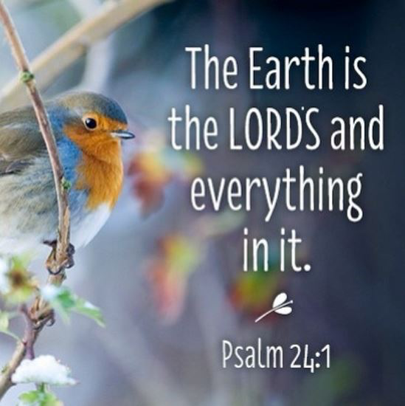
If He Owns It, He Can Give It!
The HEATHEN is part of the Son’s inheritance

Slide 10
WHO SHOULD ASK?
As many as received Him, to them, gave He power to become the SONS of God, even as many as believe on His Name John 1:12
Only SONS Have
The Rights To Ask
“The Spirit itself beareth witness with our spirit, that we are the children of God: And if children, then heirs; heirs of God, and joint-heirs with Christ…” Romans 8:16-17
Slaves and Strangers cannot possess the inheritance no matter how hard they work.

Slide 11
The Rights Of
To the Father
“For through him (Jesus) we both have access by one Spirit unto the Father.” Ephesians 2:8
“In whom (Jesus) we have boldness and access with confidence by the faith of him.” Ephesians 3:2
We are seated with the Father in the heavenly places. Alleluia!!! (Ephesians 2:5)

Slide 12
The Rights Of
The promise in Psalms 2:8 is to sons. Only the Sons have the rights to use Jesus’ name in prayers
“And whatsoever ye shall ask in my name, that will I do, that the Father may be glorified in the Son. If ye shall ask any thing in my name, I will do it.” John 14:13-14

Slide 13
WHY ASK?
The Army Of Occupation has formed a RESISTANCE to frustrate the growth of the FGBMFI Work
We are not experiencing the Power of the Holy Spirit as we should
We don’t see dead men coming alive in droves again
Our nation’s Gates have been taken over by the Army of Occupation. Righteousness has been outlawed and our nation lies in ruins.
A lot of our Chapters are ailing, weak or dead.

Slide 14
We Are In A
And It Begins With Asking Of Him
“Ask of me, and I shall give thee the heathen for thine inheritance, and the uttermost parts of the earth for thy possession.” Psalms 2:8

Slide 15
…In Faith
& With Importunity
HOW TO ASK?
“Who through faith subdued kingdoms, wrought righteousness, obtained promises, stopped the mouths of lions.” Hebrews 11:33
By Faith, We Can Have Whatsoever We Say.
Mark 11:23

Slide 16
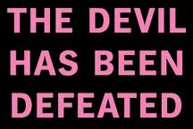
HOW TO ASK?
…With
Knowledge of His will & victory
“Having disarmed principalities and powers, He made a public spectacle of them, triumphing over them in it.” Colossians 2:15(NKJV)
“And you are complete in Him, who is the head of all principality and power.” Colossians 2:10 (NKJV)

Slide 17
HOW TO ASK?
…With A
Clean Heart
“Who shall ascend into the hill of the Lord? or who shall stand in his holy place? He that hath clean hands, and a pure heart; who hath not lifted up his soul unto vanity, nor sworn deceitfully.” Psalms 24:3,4
“If I regard iniquity in my heart, the Lord will not hear me.” Ps.66:18

Slide 18
WHAT TO ASK FOR?
Develop an ever expanding prospect list of unsaved people around you. Pray for their salvation continuously and reach them with the Gospel.
Ask God for the Heathen. Those ice-cold men in your community, family, office, profession etc.
ASK, GO & BRING The Men In

Slide 19
WHAT TO ASK FOR?
The Seven GATES
Ask God for the Gates of Nigeria and of other nations (Matt 16:19)
Arts, Entertainments & Sports
Business & Finance
Church & Religion
Distribution, Media & Communication
Gen 22:17KJV “and thy seed shall possess the gate of his enemies”.
Education & Training
Family & Community
Government & Law
Notes:
`

Slide 20
What
Asking Of God For The Heathen, The Gates and The Nations Is Seeking First The Kingdom Of God.
And God shall add to you “all these other things”. Matthew 6:3,4
God Is Saying:
“Then you shall again discern Between the righteous and the wicked, Between one who serves God And one who does not serve Him.” Malachi 3:18 (NKJV)

Slide 21
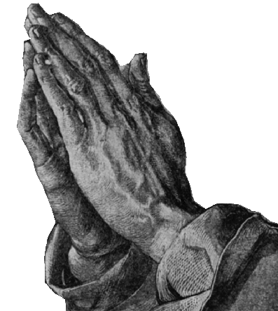
The Heathen, The Gates & The Nations Are Waiting
So,Go Ahead & ASK!
Let Us
PRAY

Slide 22
How Will You Maintain A Consistent & Heart-Felt Prayer Effort In Your Chapter?
How Will You Mobilize The Men To Possess The Gates?
Has Your Chapter, Area Or Zone Adopted A Nation?

Slide 24
OPERATION
ASK, GO & BRING The Men In
NT1802

Slide 25
OPERATION
5 Minutes of
Prayer Daily for the Prospects
5 Non-Christian
Prospects you are asking of the Lord
5 Things you should be prepared to do to bring the Prospects in
5 Minutes of
Prayer at each FGBMFI meeting

Slide 26
PROSPECTS’ LIST: Developing a prospects’ list is one of the inspired methods God gave our Fellowship.
PRAYER: Our Fellowship was birthed in agonizing prayers. Men can only be reached as we pray
BRINGING THEM IN: It’s the Lord’s command and the FBGBMFI’s first mission. As LIGHT, we are to Go and shine in the dakness. As SALT, we are to engage (mingle and connect) to impact
Is a form of PERSONAL EVANGELISM -reputed as the best way of reaching men for Christ.

Slide 27
To inspire the men to ASK for the heathen
To motivate the men to GO and BRING the heathen in
To grow the chapters and the Fellowship through active involvement of the men in evangelism

Slide 28
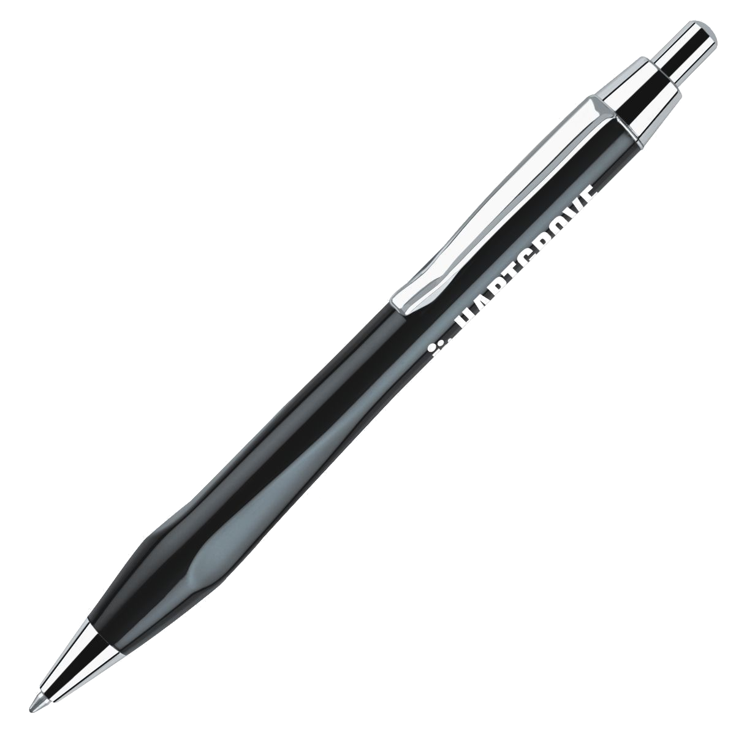
Prayerfully write names of, at least, 5 people you are asking the Lord to give to you from among the heathen
PROSPECTS
To draw of your prospects’ list, consider these sources: family, friends relations, neighbours, colleagues, clients, etc

Slide 29
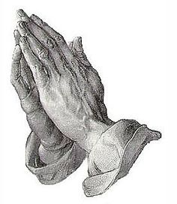
MINUTES
Pray 5 minutes everyday at your personal/family altar for the prospects by name
Pray 5 minutes for all members’ Prospects at every FGBMFI meeting

Slide 30
Be fervent
Be persistent
Stay in His will
MINUTES
“Ask of me, and I shall give thee the heathen for thine inheritance…” Psalms 2:8 (KJV)
“The heartfelt and persistent prayer of a righteous man (believer) can accomplish much [when put into action and made effective by God—it is dynamic and can have tremendous power].” James 5:16 (AMP)

Slide 31
Don’t just sit there doing NOTHING
1. Connect
2. Communicate
3. Model
4. Invite
5. Share

Slide 32
1. Connect
Be warm and friendly
Be a friend. Avoid judging them.
Look for common grounds – family, work, sports, economy, etc to speak about.
Attend professional and community association meetings, etc.
Be where the prospects are.

Slide 33
2. Communicate
Listen more than you speak
Avoid positioning yourself as having answers to all their questions. Just listen.
Show courtesy and respect. Avoid turn offs – words or gestures that are offensive to the prospects
Don’t barge into their lives. Ask for permission to pray or share a thought

Slide 34
2. Communicate
Avoid attacking their tribal or religious values. Rather, try and understand them.
Ask questions to make them speak. When appropriate, ask questions like; “Are you happy with your life?” or “What would you like us to pray together about?”
Use testimonies skillfully. Avoid sounding like a preacher. Be a friend.

Slide 35
2. Communicate
“Let your speech be always with grace, seasoned with salt, that ye may know how ye ought to answer every man.” Colossians 4:6 (KJV)
“Do not let any unwholesome talk come out of your mouths, but only what is helpful for building others up according to their needs, that it may benefit those who listen” Ephesians 4:29 (NIV)

Slide 36
3. Model
Speak sparingly, but live the life of Jesus generously
Model the life you want the prospects to covet.
Be real. Avoid hypocrisy. Living a lie will negatively impact your witness.
Be open. Let them know you too have challenges you are trusting the Lord to help you handle.

Slide 37
3. Model
“What you do speaks so loudly that I cannot hear what you say.” Ralph Waldo Emerson
“Let your light so shine before men, that they may see your good works, and glorify your Father which is in heaven.” Matthew 5:16

Slide 38
4. Invite
Invite prospects to FGBMFI meetings excitedly and expectantly
Make your invitation card attractive and ensure it’s properly addressed.
Don’t pester them. Treat rejection with calmness. Follow up a rejection with a statement like, “I can understand. I hope we can do this next time.”
Don’t give up. Recall how long it took you to honour the invite that led to your conversion.

Slide 39
4. Invite
“Knowing therefore the terror of the Lord, we persuade men…” 2 Corinthians 5:11
“The day following Jesus would go forth into Galilee, and findeth Philip, and saith unto him, Follow me… Philip findeth Nathaniel…Philip saith unto him, Come and see.” John 1:43, 45-46

Slide 40
5. Share
Enthusiastically share the Voice Magazine and other FGBMFI materials
Ask casually but purposely if they have read the material. If they have, ask for what they have learned.
Listen as they relate their stories and be ready to lead them to the salvation experience when they are ready.

Slide 41
5. Share
When you sense their readiness, share the Word of God and challenge them to make a decision for Christ.
If their response is positive, share with them Now That You Have Received Christ
Invite them to the warmth of an FGBMFI meeting and to consider taking membership

Slide 42
5. Share
Someone laboured over you to bring about your conversion. Are you labouring to bring others in?
“Then the Spirit said unto Philip, Go near, and join thyself to this chariot. And Philip ran thither to him, and heard him read the prophet Esaias, and said, Understandest thou what thou readest? Then Philip opened his mouth, and began at the same scripture, and preached unto him Jesus.”
Acts 8:29, 30

Slide 43
Develop an ever expanding prospect list of unsaved people around you.
BELIEVERS’
LIST
Update your Prospects’ List regularly as the prospects come to Christ.
‘
Transfer every new Christian on your PROSPECTS’ LIST to your BELIEVERS’ LIST and replace him with another Non-Christian
Begin the process of discipling the new converts on your BELIEVERS’ LIST and integrating them into the life of the Fellowship. .

Slide 44
Flood your Car, Home, Office & Briefcase with the copies of these indispensable tools...
Voice Magazine
Now That You Have
Received Christ
...And be ready to deploy them as the Holy Spirit presents you with opportunities.
Decision Card

Slide 45
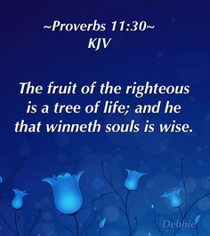
OPERATION
Don’t Just ASK of God for the heathen, GO to where they are and BRING them in

Slide 46
In your group, discuss creative ways to use OPERATION 555
Prayerfully fill out your Prospects’ List.
Pray, asking the Lord of the harvest to grant you grace and favour in this assignment.

Slide 47
NAME
TEL

Slide 49
Rediscovering Our Heritage To Reach The Men At The Gates
NT1803

Slide 50
They are part of the Resistance to God and His Son.
They are the dead and ice-cold men Demos saw in his vision
They hate church and any gathering that can convict them of their sins
God, in His wisdom, has prepared the FGBMFI Vision to reach the men at the Gates and transform our nation
The Men At The GATES

Slide 51
To effectively reach these men, we need to return to the to the basics and rediscover our heritage
With the current disconnect from our roots and heritage, it’s no surprising that many of our chapters are weak, ailing or dead.
Reaching The Men At The GATES:

Slide 52
”Remove not the ancient landmark, which thy fathers have set.” Proverbs 22:28
We need to constantly remind ourselves of the very roots, from where our Fellowship emerged and derived its relevance to God’s Kingdom, lest we derail and miss the mark.
We Have ROOTS

Slide 53
Our vision for the fellowship is based upon a series of prophetic messages given over a period of time and confirmed by a literal vision from God. In the vision, untold masses of men from every continent and nation, of all races and diverse culture and costume once spiritually dead, are now alive. Delivered and set free, they are filled with the power of God’s Holy Spirit, faces radiant with glory, hands raised and voices lifting their praises to heaven. (from page 5 of the Chapter Manual and page 10 of Super ALTS II)
We Have ROOTS

Slide 54
We see a vast global movement of laymen comprised of millions of men being used mightily by God to bring this last great harvest through the outpouring of God’s Holy Spirit before the return of our Lord Jesus Christ.
Dr. C. Price said to Demos
“Ordinary men and women. People in shops and offices and factories...Laymen, would be His most important channel – not the clergy, or the theologians, or the great gifted preachers, but men and women with ordinary jobs in the ordinary world”.
What Do We See?
(Chapter Operating Manual p 8)

Slide 55
“The Vision Is people. The vision is God’s Holy Spirit changing lives.”
Dr. Modecaii Hamm
“God gave me a revelation of the last days. It is the laymen that will reach the world…Full Gospel Business Men’s Fellowship International is God’s instrument to awaken laymen – the sleeping giant of evangelism”
The Awakened
Of
(Chapter Operating Manual page 9)

Slide 56
We depend absolutely on the Holy Spirit, as only through Him can dead men come alive.
We are a deeply spiritual people who meet regularly in social settings PRIMARILY to reach men like us and to fellowship with God and with one another. Our meetings are spiritual with social content.
We operate by the divine guidelines set in our books, to maintain the uniqueness and the cutting edge of our Fellowship.
We are not a church. We hold MEETINGS and not church services
Who Are We?

Slide 57
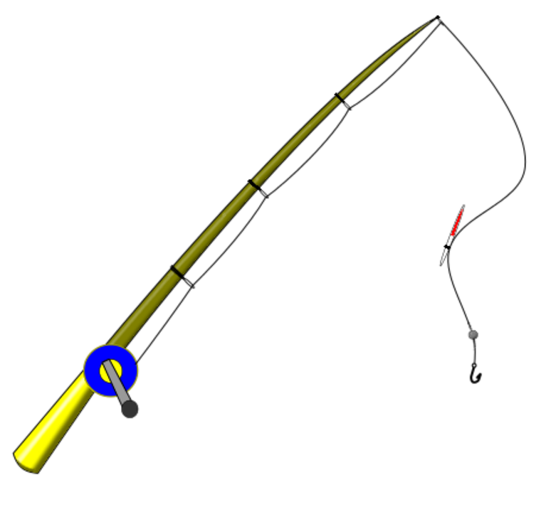
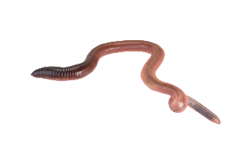
Our Social & Professional face constitutes the bait
The Financial is the fishing line supporting the hook and the bait
The hook is the Spiritual content: our stories and the demonstration of the Holy Spirit’s power.
Financial
Social
Professional
Leadership
Spiritual
Leadership provides the spiritual atmosphere and the skill that drive the meeting.
Our Meetings

Slide 59
SPIRITUAL
SOCIAL
In your group, identify 5 key activities or guidelines for each meeting component.
PROFESSIONAL
FINANCIAL
Share your findings with the rest of the class
LEADERSHIP

Slide 60
Will you commit to obtaining and reading the following books within the next one month?
#Chapter Manual
#Super ALTS II
It’s Your Pathway To Recovering The FGBMFI Heritage
#Motivation To Action Seminar
#A New Wave Of Revival: The Vision Intensified

Slide 61
If you make it a personal project to go back to the basics and rediscover the FGBMFI’s heritage by running your chapter according to the Books!
The men at the Gates will come into your chapter in droves.
Let Us Pray

